Slide 1
Self-supervision or Unsupervised Learning of Visual Representation
ECE 6554: Advanced Computer Vision Spring 2017
Badour AlBahar

Slide 2
Supervised Learning
x₂
Its goal is to learn to produce the correct output given a new input.
x
x
x
x
x
x
o
o
o
o
o
o
x₁
Data is labeled
http://mlg.eng.cam.ac.uk/zoubin/course05/lect1.pdf

Slide 3
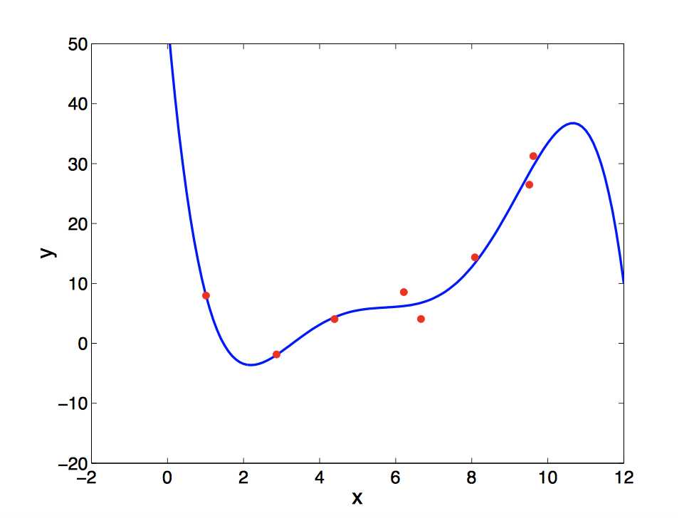
Supervised Learning
x₂
Classification
Output:
discrete class labels
Goal:
classify new inputs correctly
Regression
Output:
continuous values Goal:
predict the output accurately for new inputs
x
x
x
x
x
x
o
o
o
o
o
o
x₁
http://mlg.eng.cam.ac.uk/zoubin/course05/lect1.pdf

Slide 4
Unsupervised Learning
x₂
Its goal is to build a model that can be used for reasoning, decision making, predicting things, communicating, etc.
For example:
finding clusters
dimensionality reduction
o
o
o
o
o
o
o
o
o
o
o
o
x₁
Data is unlabeled
http://mlg.eng.cam.ac.uk/zoubin/course05/lect1.pdf

Slide 5
Motivation and Strengths:
Unsupervised learning is not expensive and time consuming like supervised learning.
Unsupervised learning requires no human intervention.
Unlabeled data is easy to find with large quantities, unlike labeled data which is scarce.

Slide 6
Weaknesses:
More difficult than supervised learning because there is NO:
Gold standard (like an outcome variable)
Single objective (like test set accuracy)

Slide 7
Unsupervised Visual Representation Learning by Context Prediction C. Doersch, A. Gupta, A. A. Efros ICCV 2015
Semantic labels from humans are expensive.
Do we need semantic labels in order to learn a useful representation?
Or is there some other “Less Expensive” pretext task that will learn something similar?
Slide: Carl Doersch

Slide 8
Context Prediction
Given a pair of patches from one image.
Can you say where they go relative to one another?
A
B
Slide: Carl Doersch

Slide 9
Context Prediction for Images
?
?
?
?
?
A
B
?
?
?
Slide: Carl Doersch

Slide 10
Semantics from a non-semantic task
Slide: Carl Doersch
Notes:
- This is hard if you don’t know what a bus is, but easy if you do.
- We hope that if we give this task to a machine learner, it will also solve it by recognizing semantics.

Slide 11
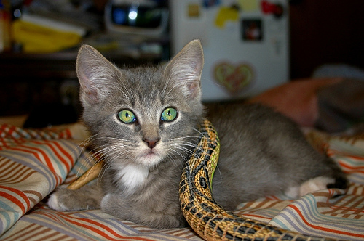
Relative Position Task
unlabeled image
Slide: Carl Doersch
Notes:
- Let’s ask a machine learner to solve this. Given an unlabeled image, we sample one patch uniformly at random, and then a second patch from one of these 8 possible locations relative to the first.
- We then pass both patches to a deep network which is trained to predict which of the 8 classes was sampled.
- Note the structure of this network: we have a relatively complex embedding that happens in parallel for both patches, followed by a relatively simple classifier that receives input from both patches. We expect that this will encourage the network to extract semantics, because that’s what makes life easier for the simple classifier.
- This embedding function can be transferred to other problems

Slide 12
Relative Position Task
8 possible locations
Classifier
CNN
CNN
Randomly Sample Patch
Sample Second Patch
Slide: Carl Doersch
Notes:
- Let’s ask a machine learner to solve this. Given an unlabeled image, we sample one patch uniformly at random, and then a second patch from one of these 8 possible locations relative to the first.
- We then pass both patches to a deep network which is trained to predict which of the 8 classes was sampled.
- Note the structure of this network: we have a relatively complex embedding that happens in parallel for both patches, followed by a relatively simple classifier that receives input from both patches. We expect that this will encourage the network to extract semantics, because that’s what makes life easier for the simple classifier.
- This embedding function can be transferred to other problems

Slide 13
Avoiding Trivial Shortcuts
Ways that the network can solve the problem without really extracting the semantics that we’re after.
Slide: Carl Doersch
Notes:
- The way that we extract the patches is important. The problem is that there are trivial shortcuts: ways that the network can solve the problem without really extracting the semantics that we’re after, like the line in this pair of patches.
- The gap makes it less likely that low-level properties cross both patches
- The jittering makes it harder to match straight lines between two patches

Slide 14
Avoiding Trivial Shortcuts
Include a gap
makes it less likely that low-level properties cross both patches
Jitter the patch locations
makes it harder to match straight lines between two patches
Slide: Carl Doersch
Notes:
- The way that we extract the patches is important. The problem is that there are trivial shortcuts: ways that the network can solve the problem without really extracting the semantics that we’re after, like the line in this pair of patches.
- The gap makes it less likely that low-level properties cross both patches
- The jittering makes it harder to match straight lines between two patches

Slide 15
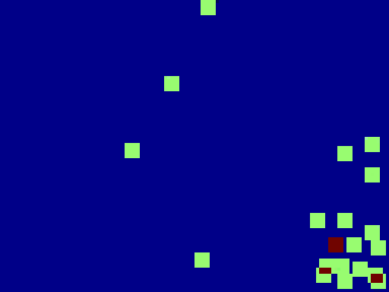
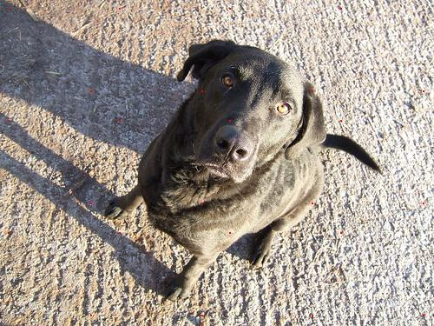
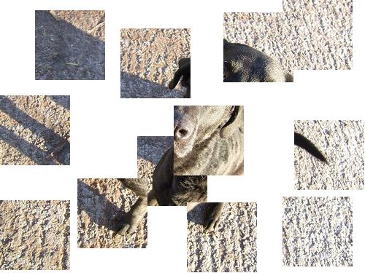
A Not-So “Trivial” Shortcut
CNN
Position in Image
Slide: Carl Doersch
Notes:
- After training for a while, another “trivial” shortcut started to take hold, which was difficult to track down. We first noticed pairs that the net could predict much better than people.
- We found its nearest neighbors were other textures with little else in common
- We then looked at the distribution of where those nearest-neighbor patches were occurring in the original image frame—turned out they were all from the same corner of the image
- Was the network figuring out where the patches were on the image frame? To find out, we trained a separate network to predict the absolute (x,y) coordinates of individual patches.
- For some images (not all), the net predicted very well, even for patches with no semantics in them.

Slide 16
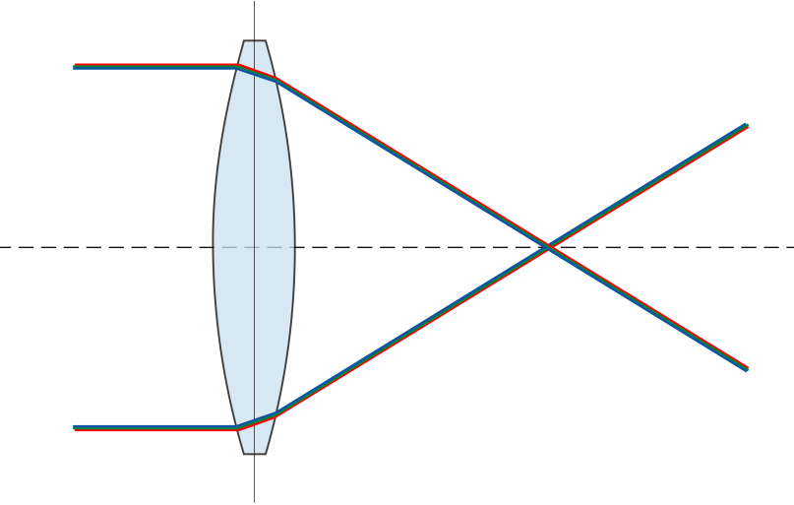
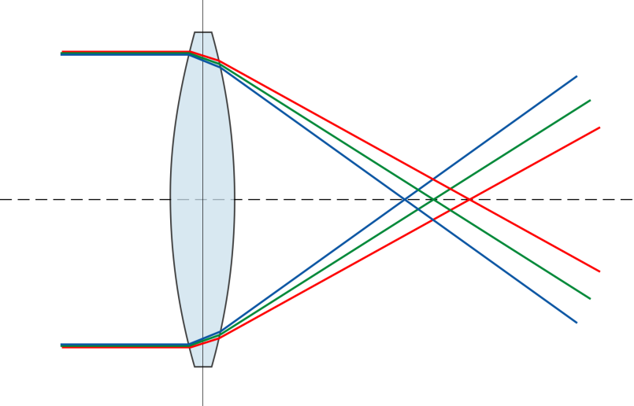
Chromatic Aberration
Chromatic aberration happens when a lens bends different wavelengths at different amount
For common lenses (specifically, the achromatic doublet), the green color channel is shrunk a little bit toward the image center relative to red and blue
Deep nets can detect this subtle shift, which tells the net where a patch is with respect to the lens, and gives away the answer to the relative-position task.
Slide: Carl Doersch
Notes:
- Turns out that the images where this worked were those affected by chromatic aberration
- Chromatic aberration happens when a lens bends different wavelengths a different amount
- For common lenses (specifically, the achromatic doublet), the green color channel is shrunk a little bit toward the image center relative to red and blue
- Deep nets can detect this subtle shift, which tells the net where a patch is with respect to the lens, and gives away the answer to the relative-position task.

Slide 17
Solution
Removing color
In this paper, 2 of the 3 color channels are randomly dropped.
Important lesson:
Deep nets are kind-of lazy. If there’s a way to solve a problem without learning semantics, they may learn to do that instead.
Slide: Carl Doersch
Notes:
There’s various ways to fix this—for example, removing color (for our experiments, we randomly dropped 2 of the 3 color channels).
But there’s a more important lesson: Deep nets are kind-of lazy. If there’s a way to solve a problem without learning semantics, they may learn to do that instead.

Slide 18
Pre-Training for R-CNN
Pre-train on relative-position task, w/o labels
[Girshick et al. 2014]
Notes:
- If we can mine objects, can we detect them? We adopt the R-CNN pipeline on VOC 2007.

Slide 19
Pascal Object Detection: VOC 2007 Performance (pretraining for R-CNN)
54.2
% Average Precision
46.3
40.7
ImageNet Labels
Ours
No Pretraining
Slide: Carl Doersch

Slide 20
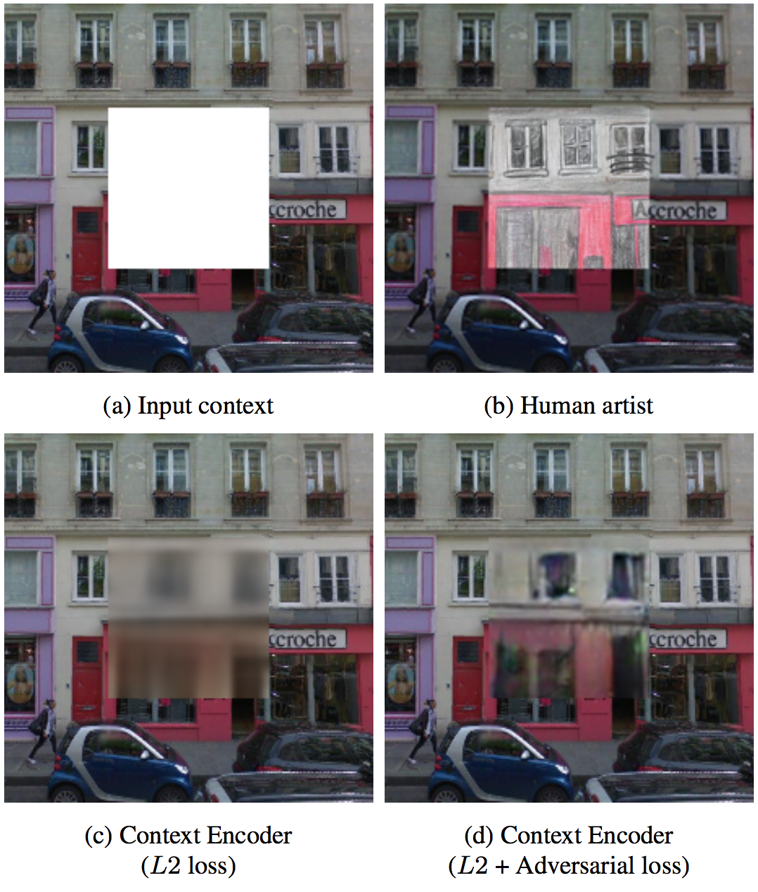
Context Encoders: Feature Learning by Inpainting D. Pathak, P. Krähenbühl, J. Donahue, T. Darrell, A. A. Efros, CVPR 2016
Inpainting:
The art of restoring missing parts of image.

Slide 21
Context Encoders: Feature Learning by Inpainting
Classical inpainting or texture synthesis approaches are
local non-semantic methods
Hence, they cannot handle large missing region.

Slide 22
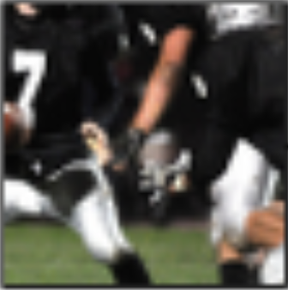
Context Encoders: Feature Learning by Inpainting
Unsupervised semantic visual feature learning
Semantic inpainting
Input:
an image with a missing region
Output:
the missing region

Slide 23
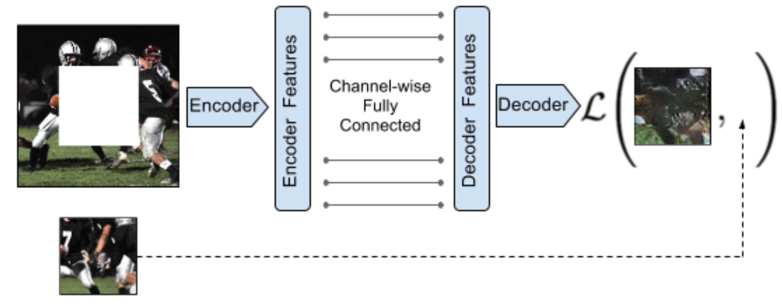
Context Encoders: Feature Learning by Inpainting
Output: a latent feature representation of that image
Input: a latent feature representation of that image
Encoder: captures the context of an image into a compact latent feature representation
Decoder: fill in realistic image content
Output: the missing image content
Input: image with the missing region
Loss function
Ground truth

Slide 24
Loss function
Input
Standard pixel-wise reconstruction loss (L2):
Tries to minimize the distance between the predicted missing region and the ground truth.
produces blurry results
Reconstruction plus an adversarial loss:
Tries to make the predicted missing region as realistic as possible.
Produces much sharper results
L2 loss
L2 + adversarial loss

Slide 25
Results

Slide 26
EXPERIMENT Context Encoders: Feature Learning by Inpainting
ECE 6554: Advanced Computer Vision Spring 2017
Badour AlBahar

Slide 27
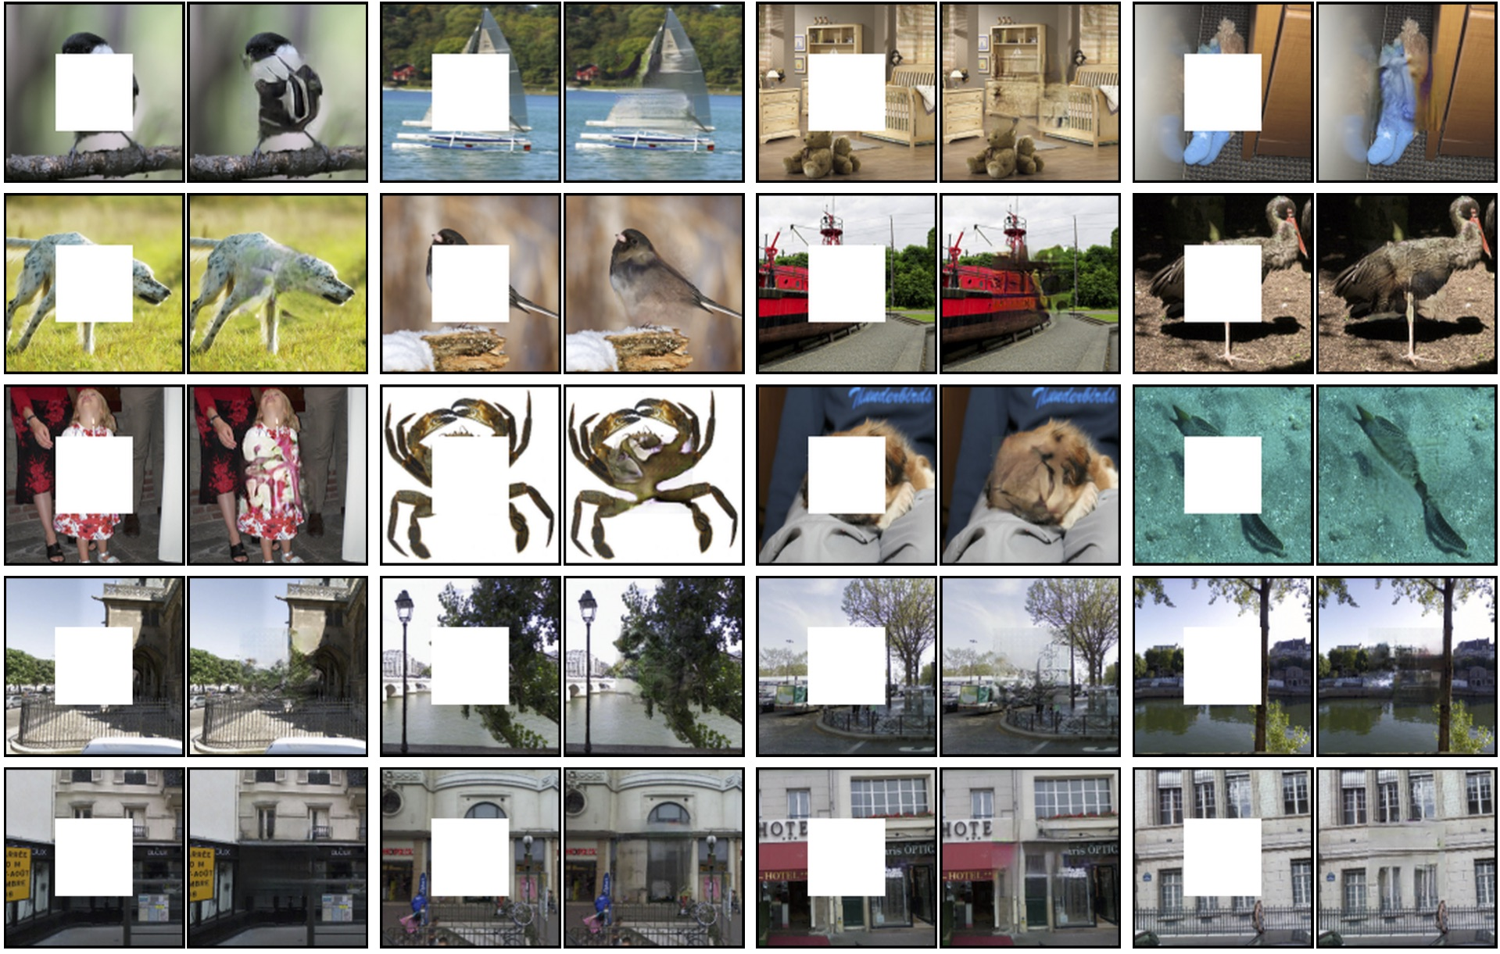
Results:

Slide 28
Results:
Original
Input
Output

Slide 29
Results:
Original
Input
Output

Slide 30
Results:
Original
Input
Output

Slide 31
Results:
Original
Input
Output

Slide 32
Results:
Original
Input
Output

Slide 33
Results:
Original
Input
Output

Slide 34
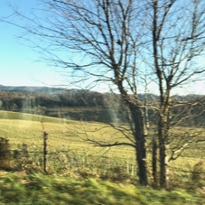
Results:
Original
Input
Output

Slide 35
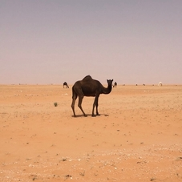
Results:
Original
Input
Output

Slide 36
Results:
Original
Input
Output

Slide 37
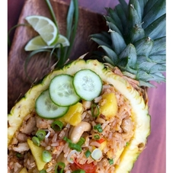
Results:
Original
Input
Output

Slide 38
Results:
Original
Input
Output

Slide 39
Results:
Original
Input
Output

Slide 40
Results:
Results:
Original
Input
Output

Slide 41
Results:
Results:
Original
Input
Output

Slide 42
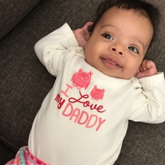
Results:
Results:
Original
Input
Output

Slide 43
Thank you!

